Slide 1

P-140 Air Quality forecasting(CO2 emissions)
Group-6
Vishal
Harigarasudhan
Swastik
Ashwini
Saurabh
Akanksha
Mentor: Adhvaith

Slide 2
Business Problem:
Air Quality forecasting(CO2 emissions)
Objective:
To forecast Co2 levels for an organization so that the organization can follow government norms with respect to Co2 emission levels.
Data Set Details:
Time parameter and levels of Co2 emission

Slide 3
Exploratory Data Analysis (EDA) and
Feature Engineering

Slide 4
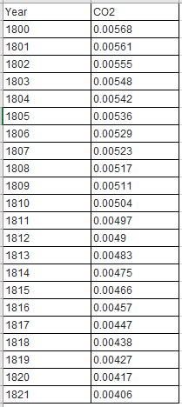
Data set details
There are 215 rows and 2 columns.
There is no null values.
There is no duplicate rows.
There are two feature, year contain integer values and co2 contain float values.

Slide 5
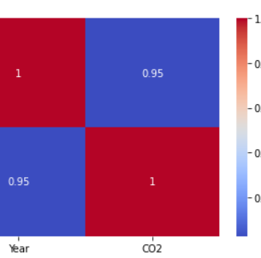
Heat map
correlation between two variable is 0.951243

Slide 6
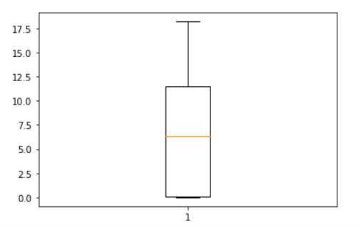
Boxplot
There is no outlier.

Slide 7
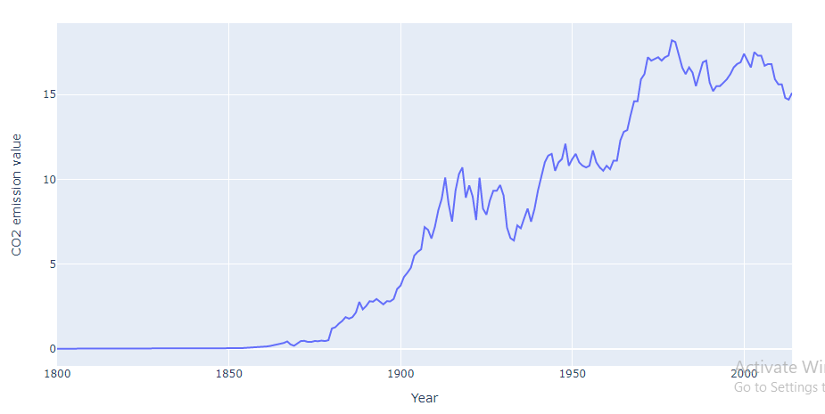
Line Plot
The Co2 emission levels hit the highest in the year 1979 by the value of 18.2 & the lowest co2 emission levels hit in the year 1845 by the value of 0.001750

Slide 8
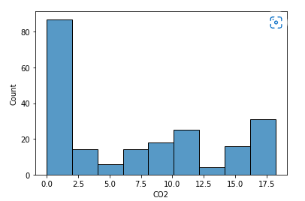
Histogram
Here we use histogram for know the distribution of co2 feature , from that we found in earlier stage there are no bigger changes in co2 emission for around 90 years , it's lying around 0 to 2 this is what we found in histogram.

Slide 9
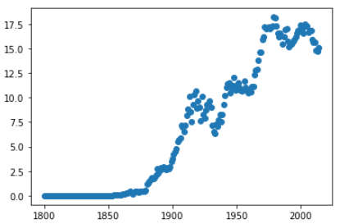
Scatter plot
With the use of scatterplot , we can know that how the data is scattered, from this plot we found that there is no trend or pattern in this dataset ,it's look like non stationarity data.

Slide 10
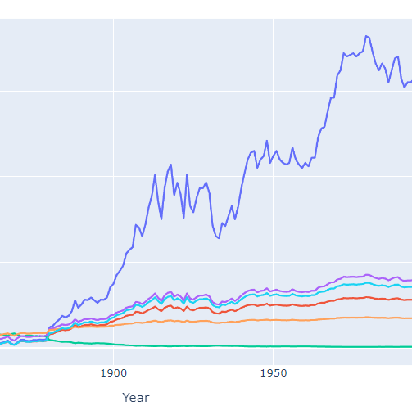
Lineplot
Here we used log transformation , reciprocal transformation , square root transformation, exponential transformation and box-cox transformation but we don’t get normal distribution so we go with the original data.

Slide 11
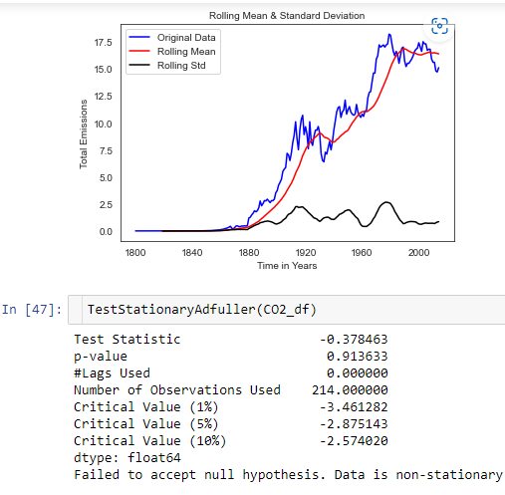
Stationarity Check
Test stationary using Augmented Dickey Fuller’s Test.
Here in the results, we can see that the p-value for time series is greater than 0.05, and we can say we fail to reject the null hypothesis and the time series is non-stationary.

Slide 12
Transforming data to Stationary
Transforming data to stationary using three following methods:
1.Moving Average
2.Differencing
3.Decomposing

Slide 13
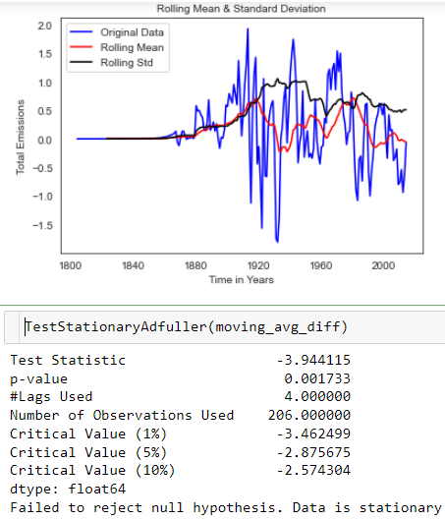
Moving average:
In the results, we can see that the p-value obtained from the test is less than 0.05 so we are going to reject the null hypothesis “Time series is stationary”, that means the time series is stationary.

Slide 14
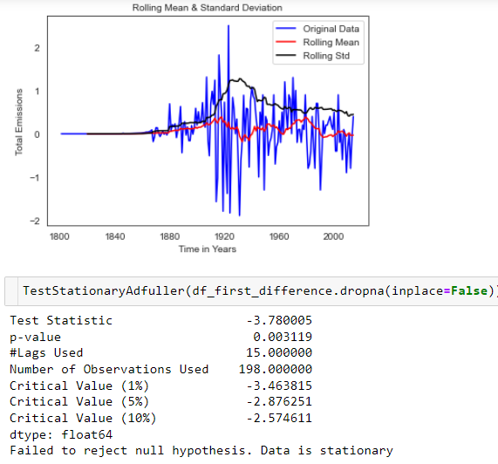
First order differencing
In the results, we can see that the p-value obtained from the test is less than 0.05 so we are going to reject the null hypothesis “Time series is stationary”, that means the time series is stationary.

Slide 15
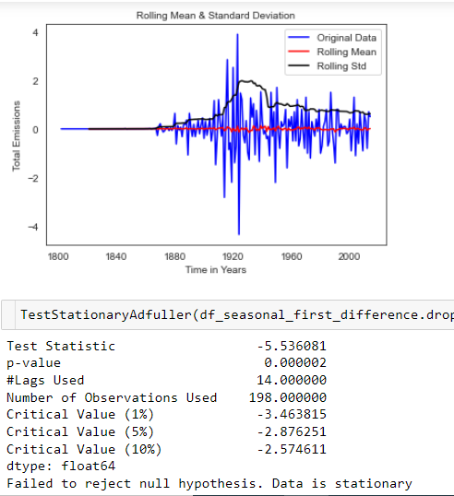
Seasonal First order differencing
We are considering this seasonal first difference for further analysis because it looks more stationary.

Slide 16
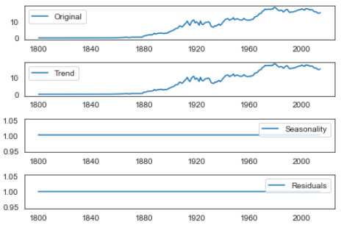
Decomposing
Here we can see that the trend, no seasonaltiy in data and we can model the trend. Here original data and trend both are equal

Slide 17
Model Building

Slide 18
Model Building
Model building done both on Stationary and non-stationary data set
Models used:
ARIMA(Auto Regressive Integrated Moving Average)
AR(Auto Regressive)
MA(Moving Average)
Simple Exponential smoothing
Double Exponential smoothing or Holt’s method
Triple Exponential smoothing or Holt’s –Winter method

Slide 19
MODEL BUILDING ON STATIONARY DATA
Plot the ACF and PACF charts.
In the next step we will be determine the tuning parameters (p and q) of the model by looking at the autocorrelation and partial autocorrelation plots. The plot below provides a brief guide on how to read the autocorrelation and partial autocorrelation graphs in order to select the parameters.

Slide 20
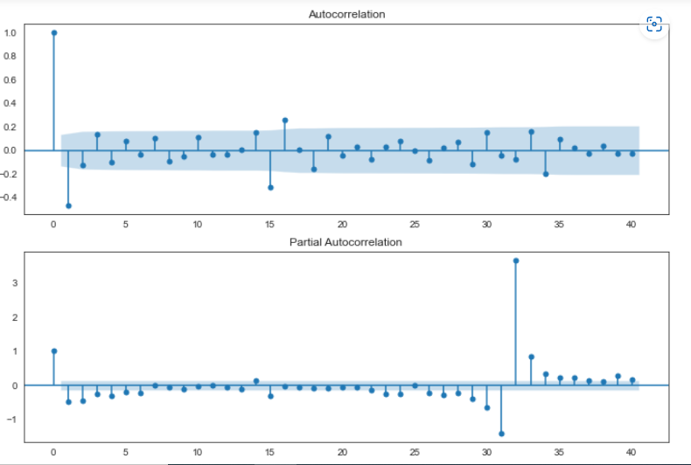
ACF & PACF plot for seasonal first order difference
ACF & PACF both above plot help us to select the parameters.

Slide 21
DATA PARTITIONING
Using Seasonal First Order Differencing data for building model for stationary data because it shows more stationarity.
Training Data = Fit the model only to training period
Validating Data = Assess the model performance on validation
No random partition That’s because the order sequence of the time series should be intact in order to use it for forecasting.

Slide 22
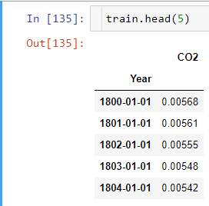
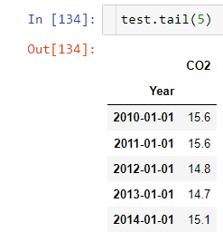
Train shape:(193, 1) Test shape: (20, 1)

Slide 23
Hyper-parameter Tuning using Grid Search
Done Grid search for hyper-parameters to find out optimal order or (p, d ,q) for ARIMA model.
Best order found is (3,0,0) with least RMSE.

Slide 24
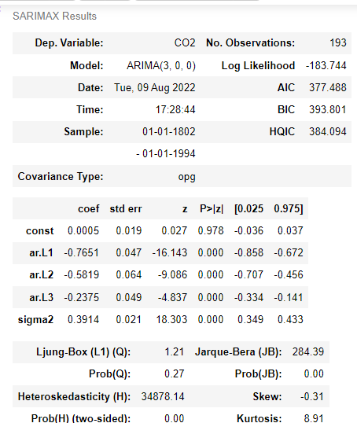
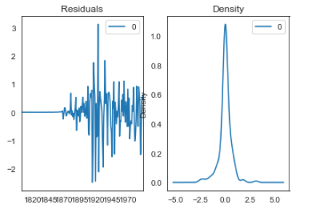
Model on Stationary Data 1.Auto Regressive Integrated Moving Average (ARIMA)

Slide 25
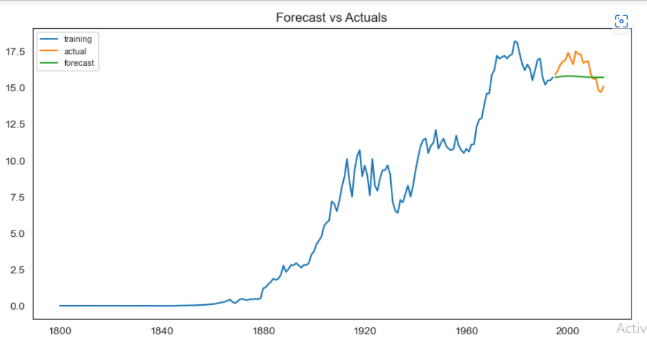
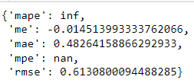

Slide 26
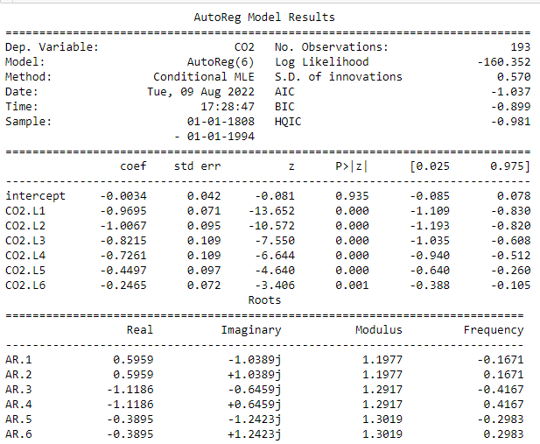
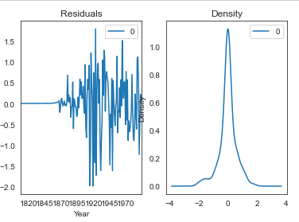
2) AUTO REGRESSOR (AR) MODEL

Slide 27
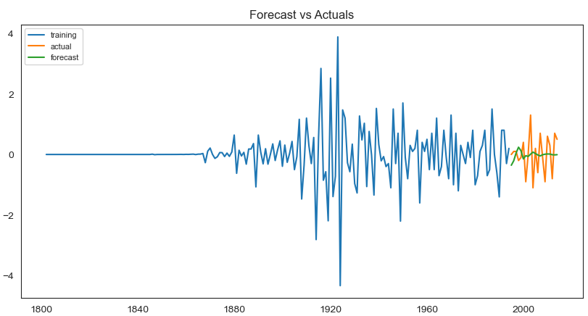
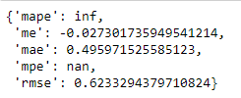

Slide 28
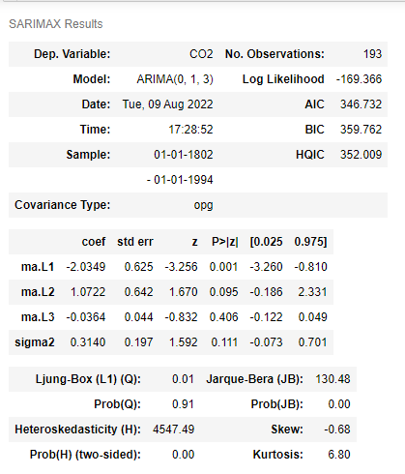
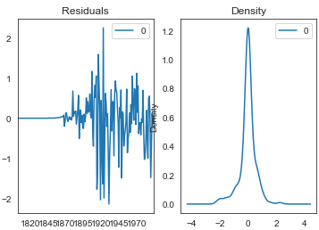
Moving Average (MA) Model

Slide 29
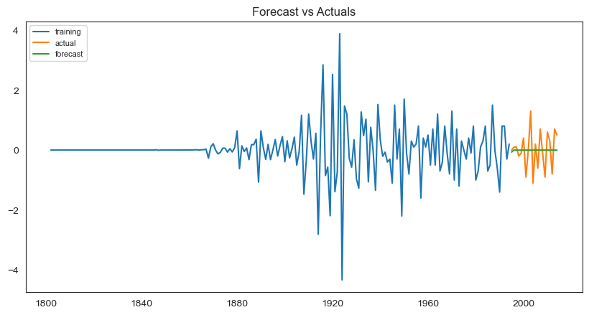
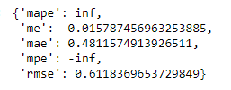
Moving Average (MA) Model

Slide 30
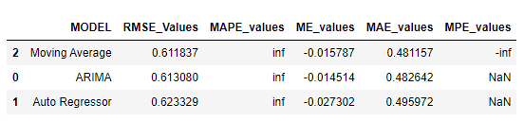
Comparing models build on stationary data Moving average gave least RMSE but other forecasting accuracy like MAPE shows infinity and MPE says NaN.

Slide 31
Model Building on Non - Stationary data
Now building model on original data which is non – stationary.

Slide 32
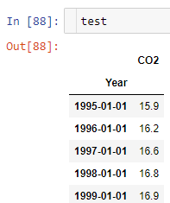
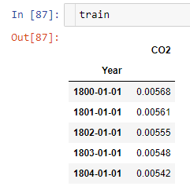
Data Partitioning

Slide 33
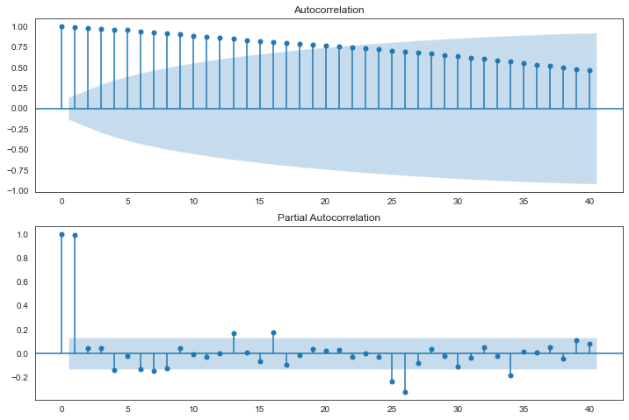
ACF & PACF Plots

Slide 34
Hyper-parameter Tuning using Grid Search
Done Grid search for hyper-parameters to find out optimal order or (p, d ,q) for ARIMA model.
Best order found is (5,1,3) with least RMSE.

Slide 35
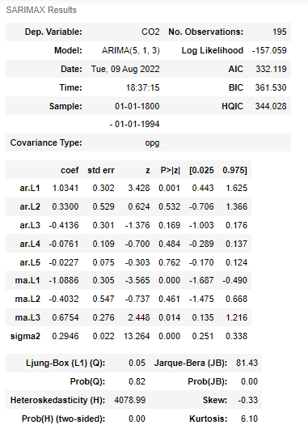
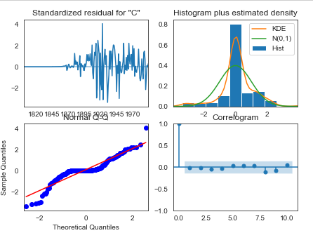
Models on Non-Stationary data Auto Regressive Integrated Moving Average (ARIMA) model

Slide 36
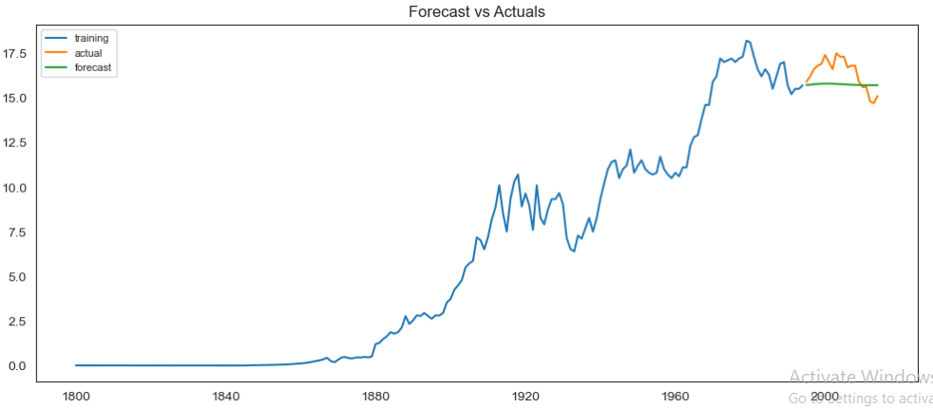
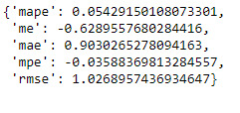

Slide 37
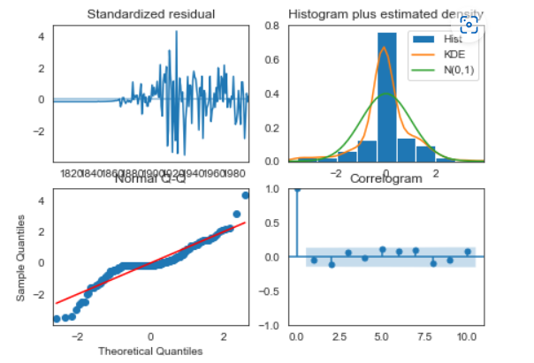
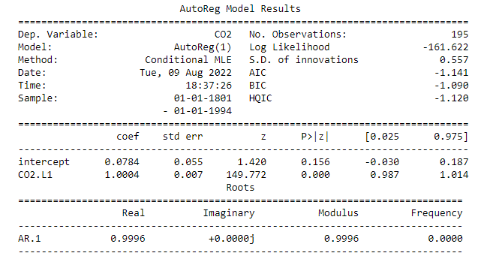
Auto Regressive (AR) Model

Slide 38
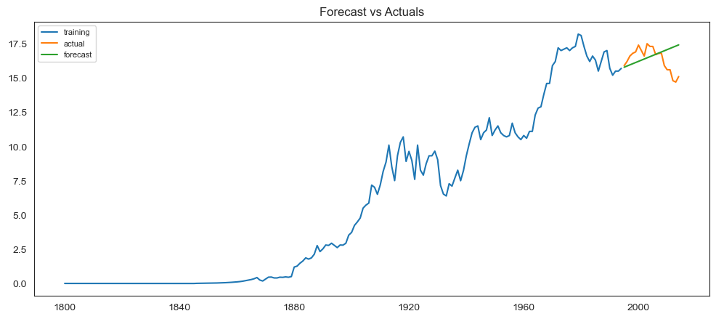
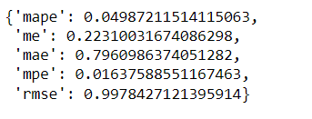

Slide 39
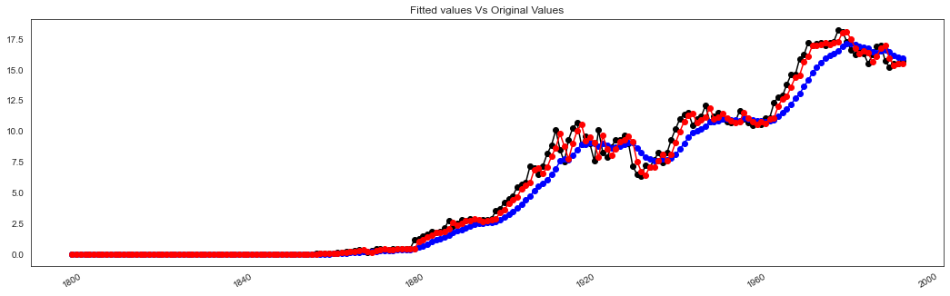
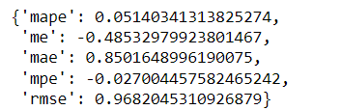
Simple Exponential Smoothing Model

Slide 40


Slide 41
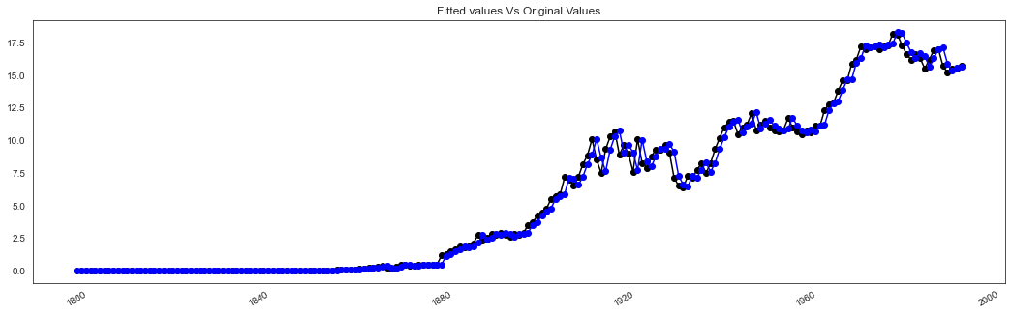
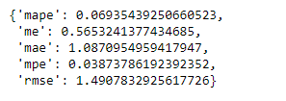
Double Exponential Smoothing or Holt’as method

Slide 42


Slide 43
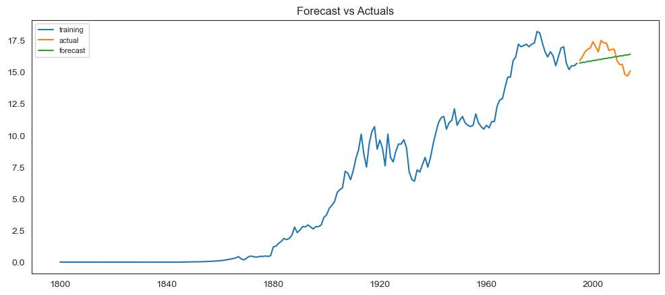
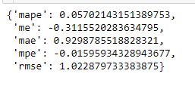
Triple Exponential Smoothing or Holt’s – Winter Method Holts winter exponential smoothing with additive seasonality and additive trend

Slide 44
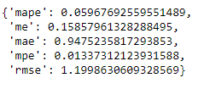

Triple Exponential Smoothing with multiplicative seasonality and additive trend

Slide 45

Triple Exponential Smoothing with multiplicative seasonality and multiplicative trend

Slide 46
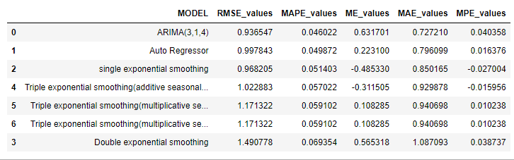
Comparing Models

Slide 47
Final Model
The Final Model selected for the deployment is ARIMA(3,1,4) which will be trained on full original non-stationary dataset
Reasons to choose this model:
Least MAPE and MAE values
Forecasted values vs Actual values graphs capturing more information when compared to other models.
Now we will train this model using full original dataset and make forecast for future years.

Slide 48
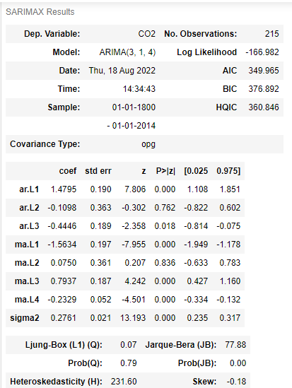
Model training on full original dataset

Slide 49
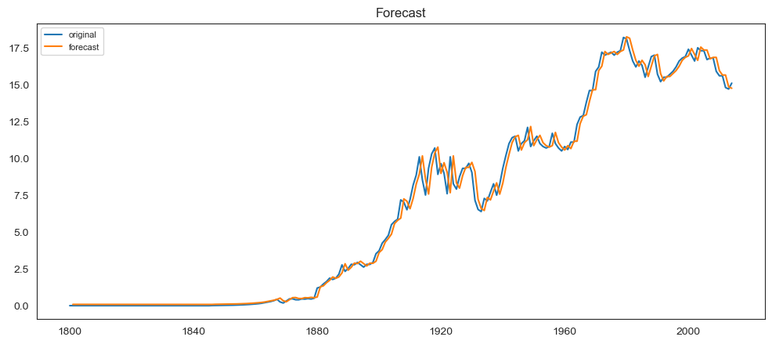
Looks like this model captures a good amount of information and we can say that model is trained well.

Slide 50
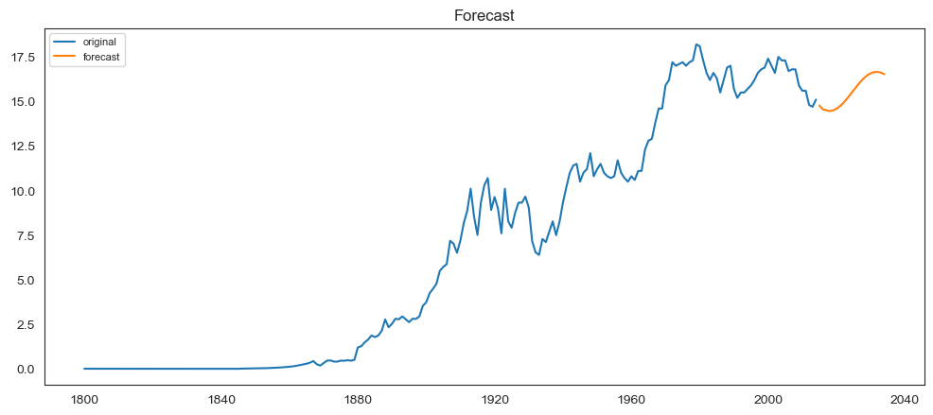

Forecasting for next 20 years

Slide 51
Model Deployment

Slide 52


Slide 53
Deployed the final model using Streamlit
Steps to run:
Open Anaconda Prompt in the project directory
Then run command : “ streamlit run website.py “
After opening of browser upload the dataset and choose number of years you want to forecast
Forecasted results and graph will be displayed

Slide 54


Slide 55
THANK YOU

